Slide 1

Computer Graphics: Rendering Topics
CS 498VR: Virtual Reality
UNIVERSITY OF ILLINOIS AT URBANA-CHAMPAIGN
Eric Shaffer

Slide 2
Interpolating Colors: Barycentric Coordinates
Describe location of point in a triangle in relation to the vertices
p=(λ₁,λ₂ ,λ₃) where the following are true
p=λ₁a + λ₂ b +λ₃c
λ₁+λ₂ +λ₃= 1
To interpolate a color f(v) sampled at the vertices we just do:
f(p)=λ₁f(a) + λ₂ f(b) +λ₃f(c)
a
p
b
c

Slide 3
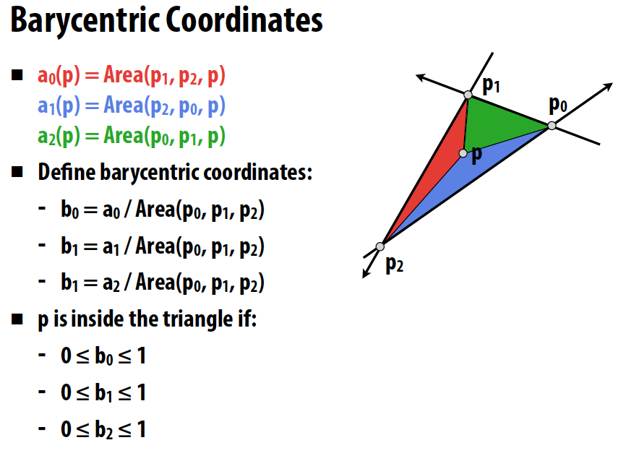
Barycentric Coordinates
should be b2 →
Image from Stanford’s CS348b: Image Synthesis by Matt Pharr
Barycentric coordinates express the location of a point p as a linear combination of the coordinates of 3 vertices
P = (b0,b1,b2)
Notes:
Can you implement a ray-triangle intersection test?

Slide 4

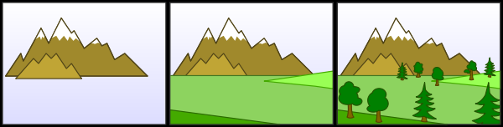
Hidden Surface Removal
We need for objects occluded by other objects to not be seen
Painters Algorithm
First method proposed for doing hidden surface removal
Sort triangles by depth
Draw the triangles into the frame buffer in sorted order
Farthest to closest
…so closer objects are drawn over farther objects
What are some problems with this?

Slide 5
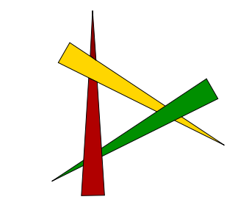
Painter’s Algorithm
It’s expensive to sort….
Also, a single triangle can have multiple depths
Occlusion cycles cannot be resolved

Slide 6
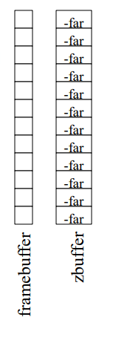
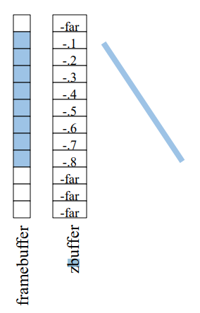
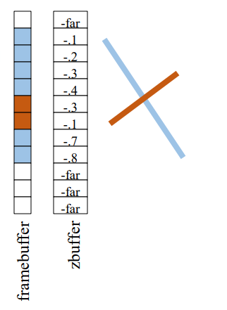
Hidden Surface Removal: Z-Buffer
In addition to the frame-buffer that stores pixel colors
Keep a Z-Buffer that stores pixel depth
For each fragment (x,y) we process check if it is closer than frame-buffer pixel
If so, update frame-buffer and Z-Buffer values

Slide 7
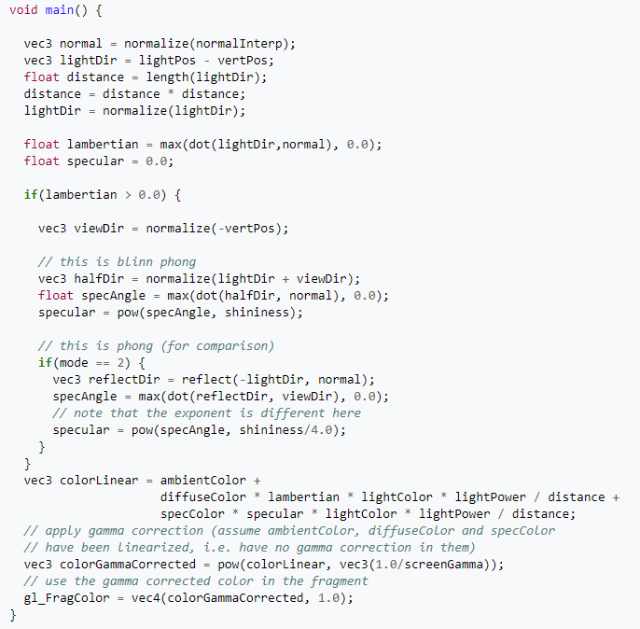
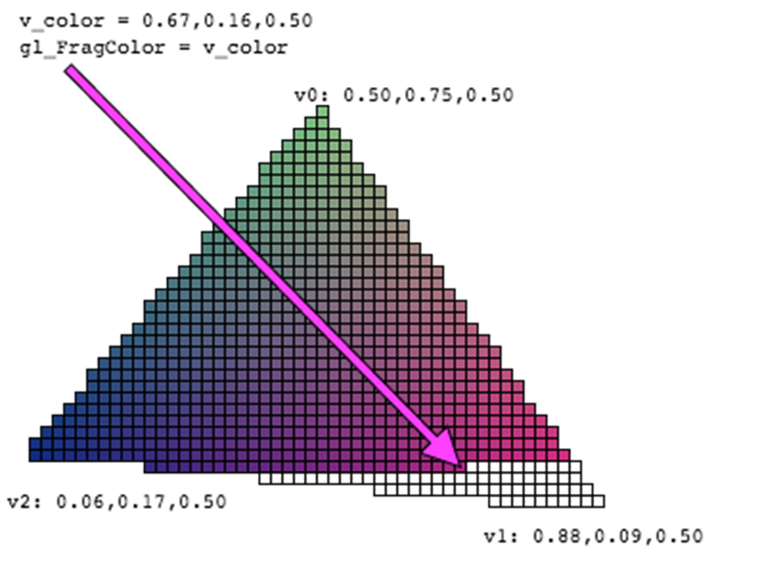
Shaders
In modern rendering systems, colors are computed by shader programs
These shader programs run on the GPU

Slide 8
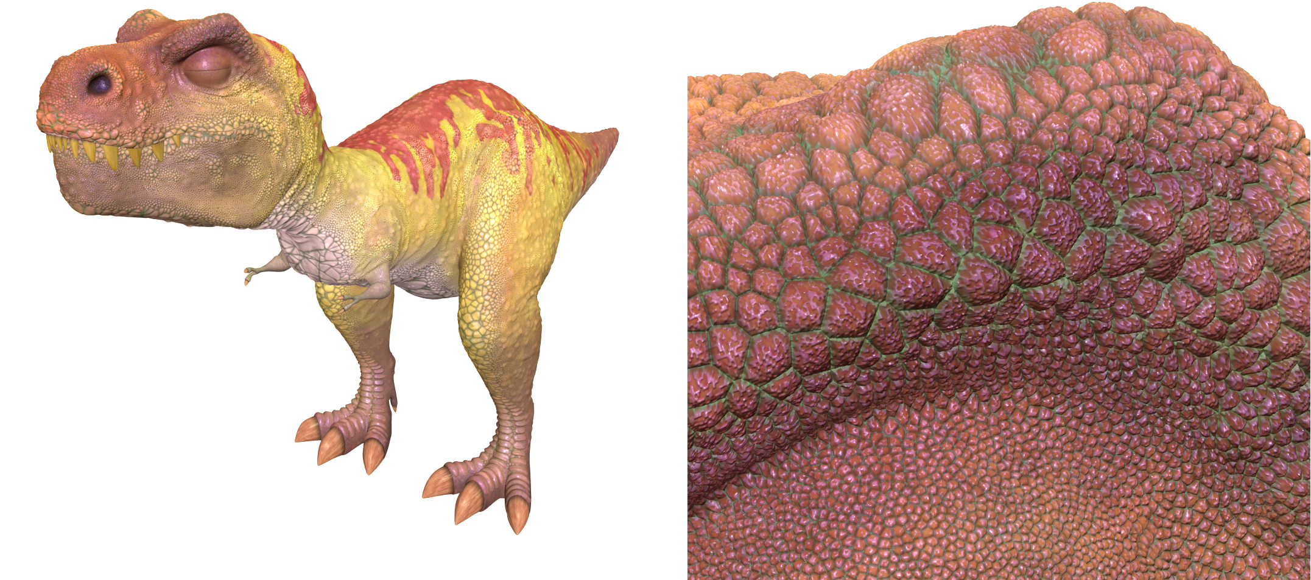
The Limits of Geometric Modeling
Graphics cards can render over 10 billion polygons per second
That number is still insufficient for many visual phenomena
Consider rendering a herd of bumpy-skinned dinosaurs

Slide 9
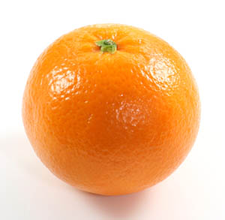
Or Consider Modeling an Orange
Consider the problem of modeling an orange
Start with an orange-colored sphere
Too simple
Replace sphere with a more complex shape
Does not capture surface characteristics (small dimples)
Takes too many polygons to model all the dimples

Slide 10
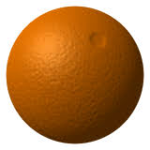
Modeling an Orange
Take a picture of a real orange
“paste” pixels of the image onto simple geometric model
This process is known as texture mapping
Still might be problematic…
Looking at the orange in a rendered scene
How could you tell the colors on the orange aren’t generated by shading?

Slide 11
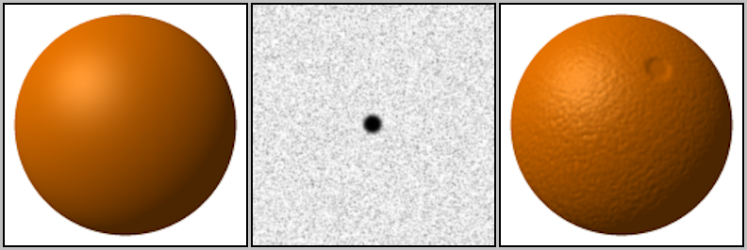
Modeling an Orange
Another alternative would be bump mapping
Use an image that specifies the normal to use to render the surface
This way, can render an “bumpy” surface during shading
Without modeling the bumpy surface with lots of triangles

Slide 12
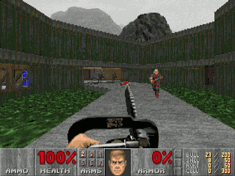
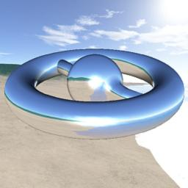
Three Types of Mapping
Texture Mapping
Uses images to fill inside of polygons
Environment Mapping
Uses a picture of the environment for texture maps
Allows simulation of mirror-like surfaces
Bump mapping
Alters normal vectors during the rendering process
Generates a bumpy looking surface

Slide 13
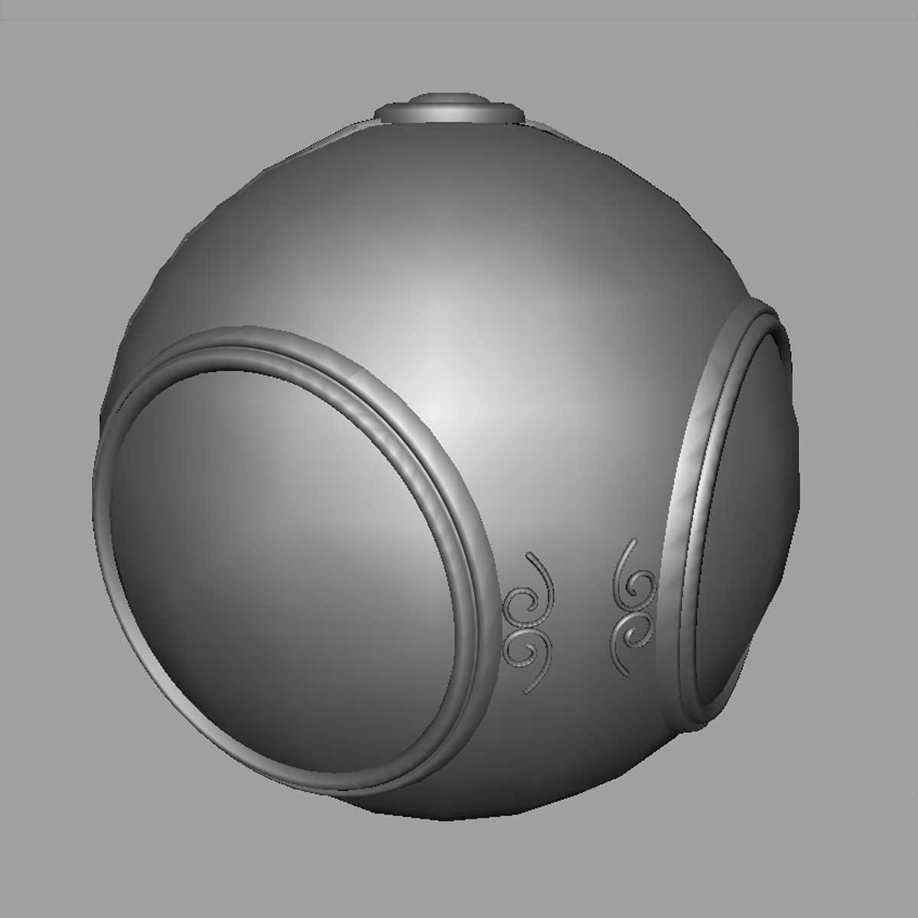
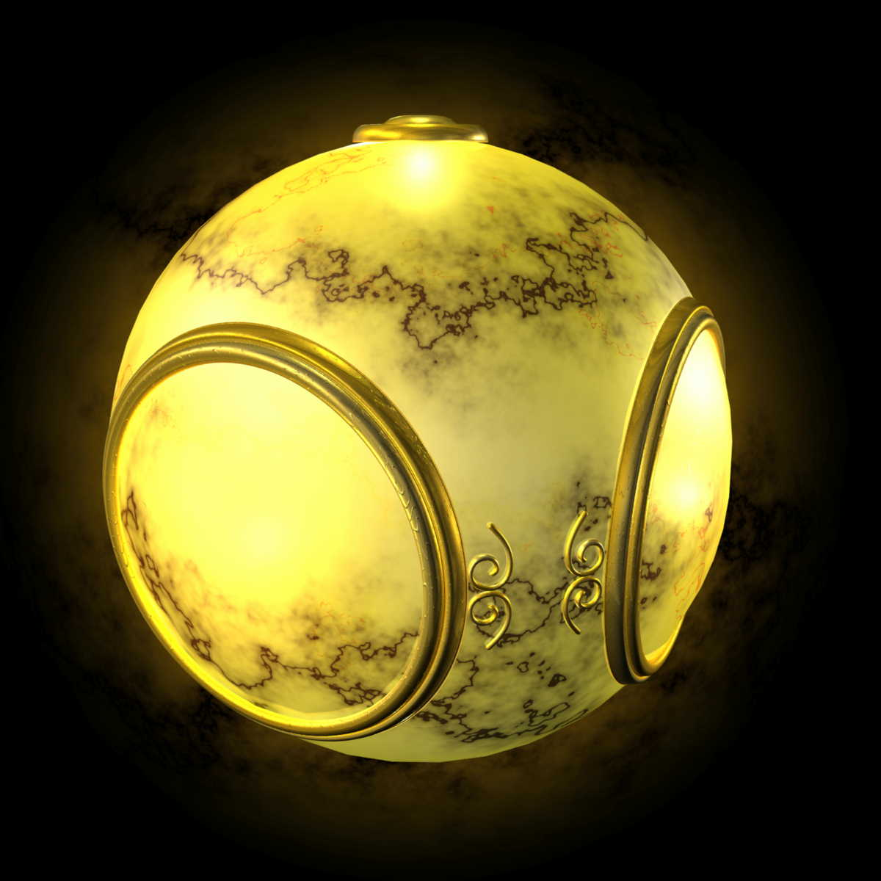
Texture Mapping
geometric model
texture mapped

Slide 14
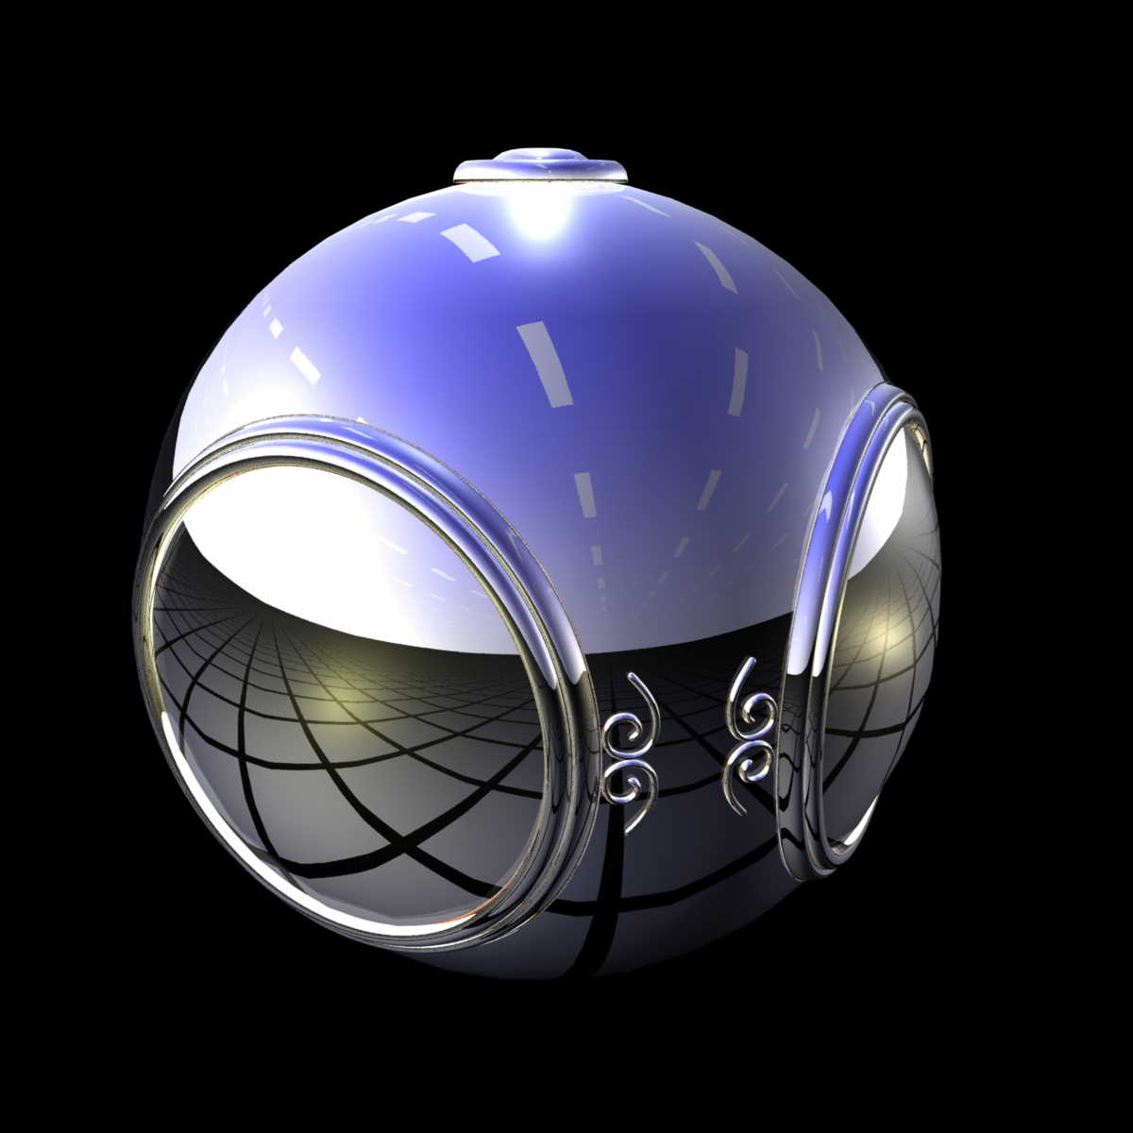
Environment Mapping

Slide 15
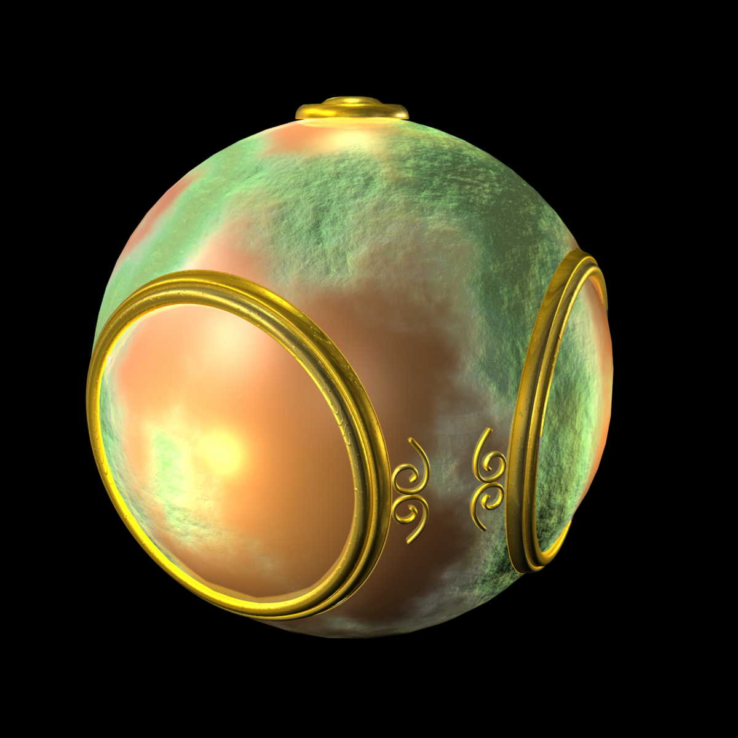
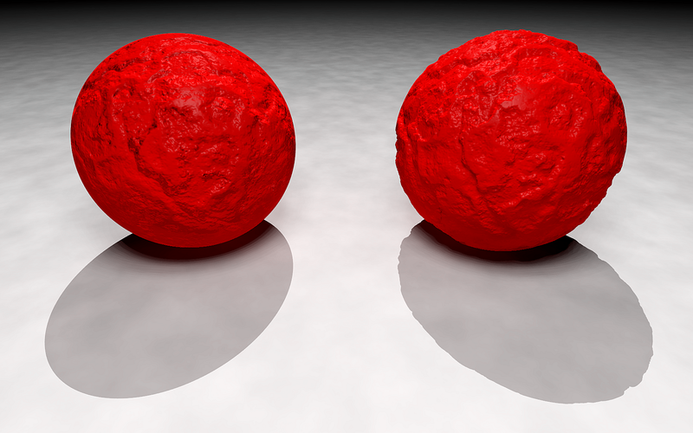
Bump (or Normal) Mapping

Slide 16
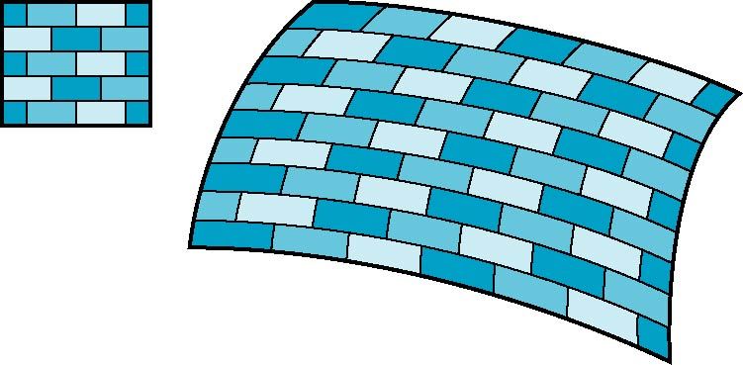
The Idea is Simple
Map an image to a surface
Each fragment samples a color from the image
2D image
3D surface

Slide 17
Specifying a Texture Mapping Function
You need to come up with a mapping from surface vertices → texture space
Specify mapping using (u,v) vertex attributes
The (u,v) coordinates map into a parametric texture space
Generally (u,v) is in [0,1] x [0, 1]
We can allow coordinates to go outside that range...
if we tell WebGL how to handle that event …more on that later

Slide 18
Mapping a Texture
Based on parametric texture coordinates
Specify as a 2D vertex attribute
Texture Space
Object Space
v
1, 1
(u, v) = (0.2, 0.8)
0, 1
A
a
c
(0.4, 0.2)
b
B
C
0, 0
1, 0
u
(0.8, 0.4)

Slide 19
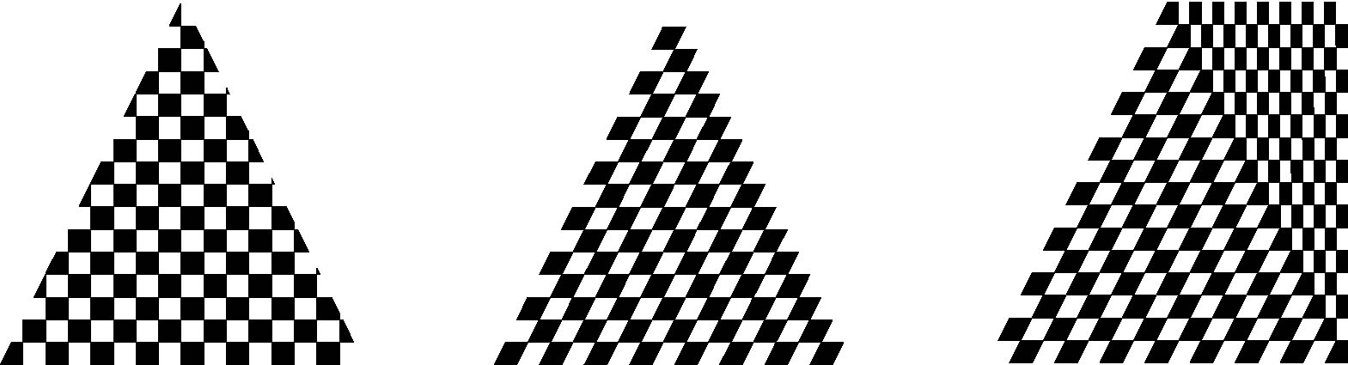
Mapping a Texture
Can be distortions
texture stretched
over trapezoid
showing effects of
bilinear interpolation
good selection
of tex coordinates
poor selection
of tex coordinates

Slide 20
Texture Filtering
We often have a mismatch between texture size and number of fragments
Requires us to adjust how the texture is sampled…
This more complicated sampling process is called texture filtering
Magnification occurs when we have more fragments than texels
Minification occurs when we have more texels than fragments
Two common mag filters
Nearest Neighbor
Bilinear
Most common min filter
Mipmapping

Slide 21
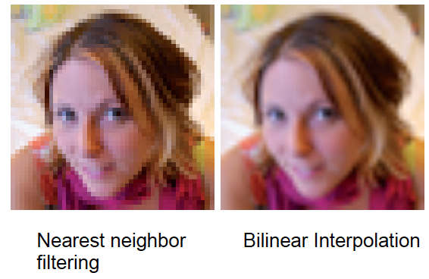
Magnification Examples

Slide 22
Mipmapping
Mipmapping is a method of pre-filtering a texture for minification
mip = “multum in parvo”…. latin: many things in small place(?)
We generate a pyramid of textures
Bottom-level is the original texture
Each subsequent level reduces the resolution by ¼

Slide 23
Sprites versus Textures
Where do you see sprites being used?
Where do you see textures being used?
What is the difference?

Slide 24
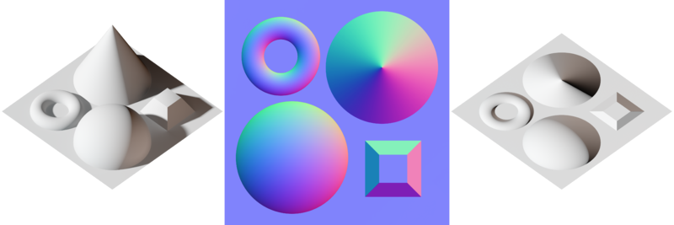
Bump Mapping and Normal Mapping
Bump Mapping:
Perturbing mesh normals to create the appearance of geometric detail
Normal Mapping:
A way of implementing bump mapping

Slide 25
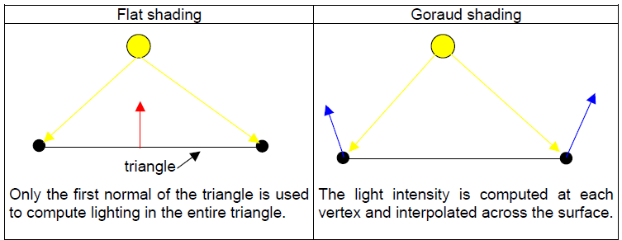
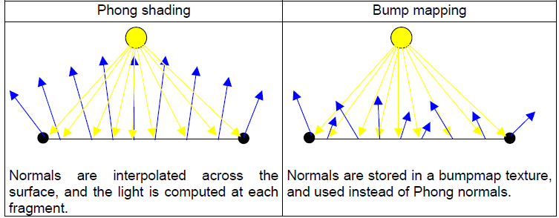
Bump Mapping and Shading

Slide 26
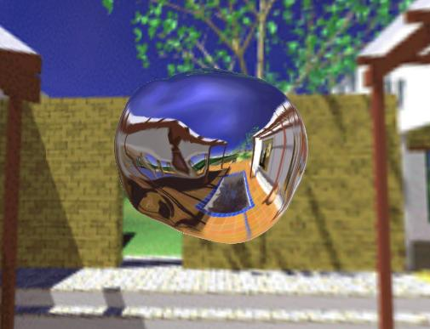
Environment Mapping
How can we render reflections with a rasterization engine?
When shading a fragment, usually don’t know other scene geometry
Answer: use texture mapping….
Create a texture of the environment
Map it onto mirror object surface

Slide 27
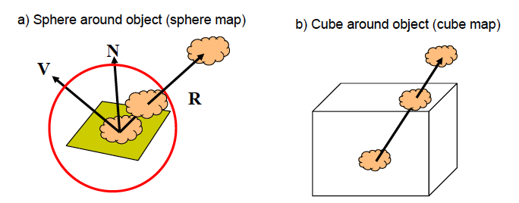
Types of Environment Maps

Slide 28
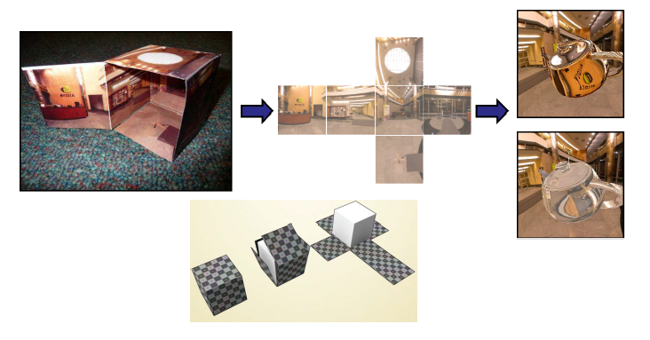
Cube Map
Cube mapping takes a different approach….
Imagine an object is in a box…and you can see the environment through that box

Slide 29
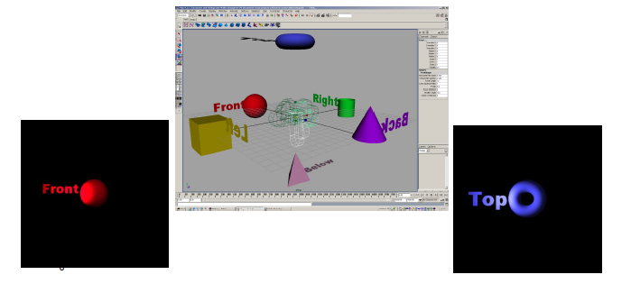
Forming a Cube Map
A cube map requires 6 images
Each covers a 90 degree angle from the center of the cube

Slide 30
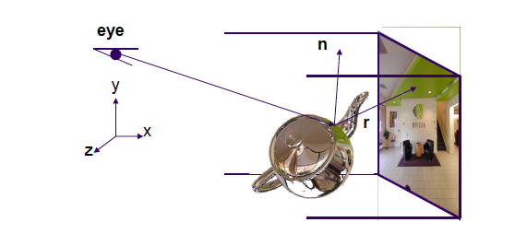
Index using the Reflection Vector

